Slide 1
Chapter 1
Applied Professional Communication

Slide 2
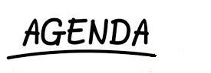
Define Communication
Levels of Communication
Value of Communication
Models of Communication
Themes of Communication
Application to Social Media

Slide 3
Why Study Communication?
Improve our skills
Intrapersonal
Interpersonal
Group
Help us make sense of what happens in our lives
Increase our personal impact
Others?

Slide 4
Defining Communication
Communication is a systemic process
In which people interact with and through symbols to create and interpret meanings
Altrendo images/Exactostock-1491/SuperStock

Slide 5
Features of Communication
Process
Ongoing and always in motion
Systemic
Occurs in a system of interrelated parts that affect one another
Person x situation = outcome
Symbols
All language and many nonverbal behaviors—anything that abstractly signifies something else

Slide 6
Levels of Communication
Meanings
The significance we bestow on phenomena—what they signify to us
Content Level – literal, denotative
Relationship Level – relationships between communicators

Slide 7
Values of Communication
Personal Identity and Health
Relationship
Professional
Cultural
michaeljung/shutterstock.com

Slide 8
Personal Identity and Health
We gain personal identity as we communicate with others
Communication directly influences our physical and emotional well-being
Communication skills are essential to effective health care

Slide 9
Relationship Values
Communication is the primary way we connect with others
Effective communication sustains relationships
Used to solve problems and resolve conflict
Used for self-disclosure
Day-to-day communication is important

Slide 10
Professional Values
Communication skills are closely linked to professional success
Poor communication increases the occurrence of mistakes, unnecessary repetition, and inferior productivity

Slide 11
Linear Model of Communication
A one-way process in which one person acts on another person
Who?
Says what?
In what channel?
To whom?
With what effect?
Noise
Anything that interferes with the intended communication

Slide 12
Noise
Physical – sounds, objects, temperature, machines, other individuals
Psychological – emotional highs or low, preoccupation with previous events, thinking of the past or future
Physiological- Bodily discomforts, differences in ability (vision, hearing, speaking, etc.)

Slide 13
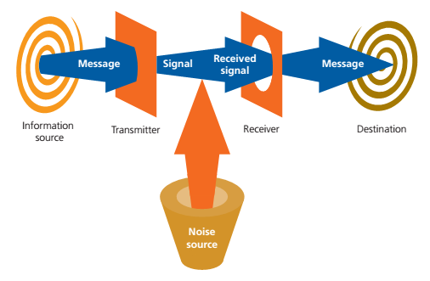
Linear Models
Cengage Learning

Slide 14
Interactive Models of Communication
Receivers respond to senders
Senders listen to receivers
Feedback
Verbal or nonverbal
Intentional or unintentional
Create and interpret within fields of experience

Slide 15
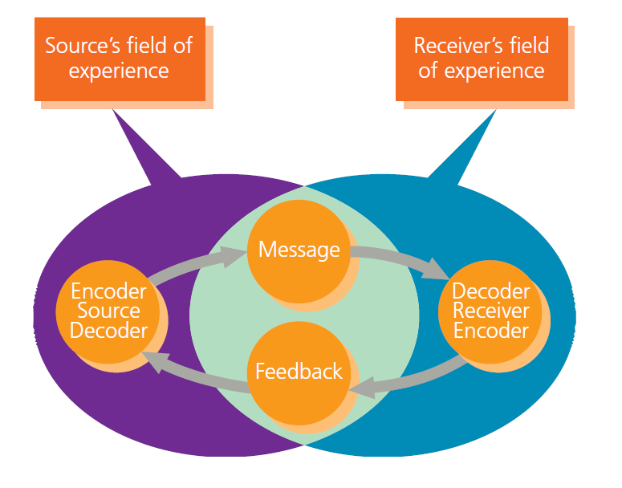
Interactive Model
Cengage Learning

Slide 16
Transactional Model of Communication
People often simultaneously send and receive messages
Communication changes over time
Communication is subject to potential interference from noise
Communication occurs within systems
Engage in an interpersonal dance

Slide 17
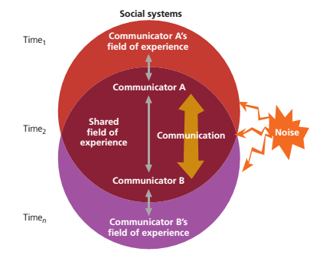
Transactional Model
Cengage Learning

Slide 18
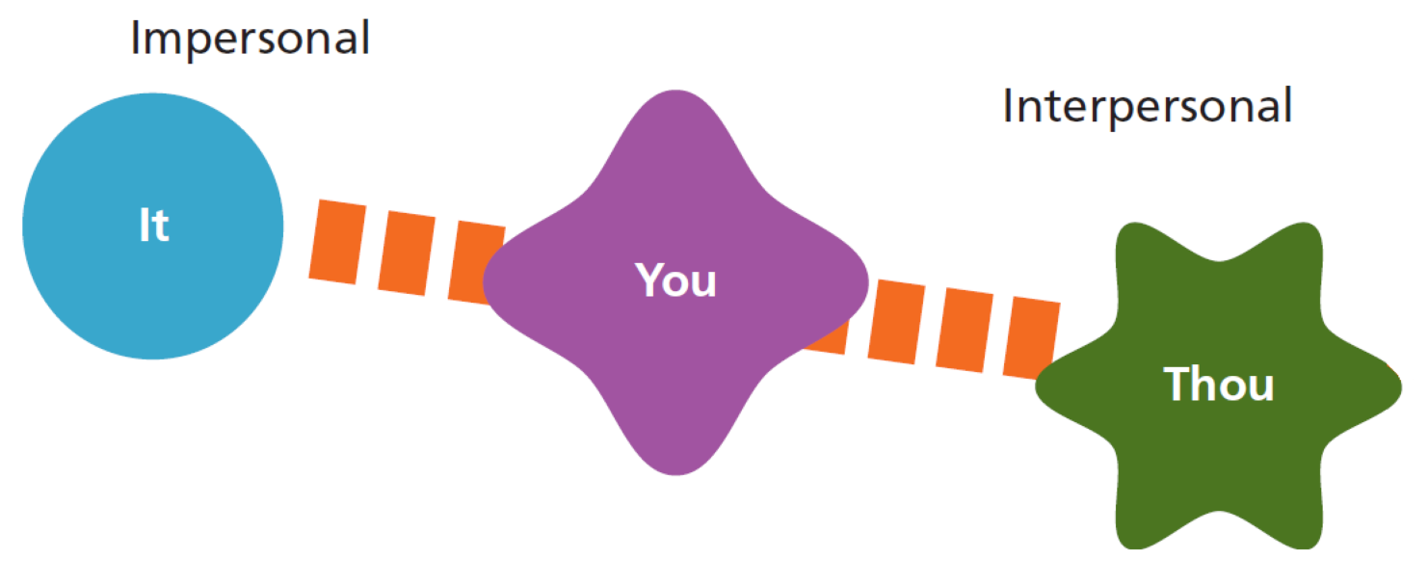
Breadth of the Field
Intrapersonal Communication
Interpersonal Communication
Group Communication
Cengage Learning

Slide 19
Breadth of the Field (cont’d)
Organizational Communication
Health Communication
Mass Communication and Digital Media
Public Communication
Intercultural Communication

Slide 20
Unifying Themes
Symbols
Meaning
Critical Thinking
Ethics and Communication
Pressmaster/Shutterstock.com

Slide 21
Careers in Communication
Education
Media Production, Analysis, and Criticism
Training and Consulting
Human Relations and Management
Research

Slide 22
Digital Media and Communication
Value
Maintaining personal relationships through social media
Job search
Civic engagement
Drawbacks
Lack of contextual cues
Delayed feedback
Missed meaning

Slide 23
Summary
Levels
Definition
Values
Chapter 1
Features
Models
Themes
Applications

